Slide 1
Hadoop and Spark
Applications of Big Data Processing

Slide 2
Table of contents
01
02
03
04
05
06
Introduction
Hadoop
Spark
Big data overview
HDFS & ecosystem
Fast data processing
PySpark
Commands
Resource
Python API for Spark
Common functions
Tools & references

Slide 3
01
Introduction
Overview of big data and motivation for using distributed processing

Slide 4
The Explosion of Big Data
Social Media
IoT Devices
Digital Activities
Real-time posts, shares, interactions
Sensors and cameras stream nonstop data
Mobiles apps and online transactions

Slide 5
Single Machine Fails to Handle Big Data
01
02
03
Current situation
A single machine lacks the capacity and reliability to handle large and growing data efficiently
Limited Scalability
Insufficient Resources
No Fault Tolerance
Cannot expand to handle growing data
Lacks CPU, memory, and I/O for big data tasks
Failure halts all processing; no recovery
Problems

Slide 6
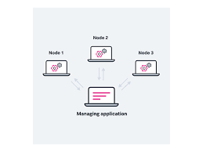
A distributed system is a group of independent computers that work together to appear as a single system to users
Data and computation are spread across multiple machines (nodes)
Nodes communicate via network
Users interact as if it's one unified system

Slide 7
Why Distributed Systems Are Essential
Scalability: Can handle ever-growing data by adding more machines
Performance: Processes data in parallel → faster results
Fault Tolerance: If one machine fails, others take over → no downtime
Cost Efficiency: Cheaper to use many small machines than one powerful server

Slide 8
Comparison
Single machine
Distributed system
Limited scalability – upgrading requires expensive hardware (scale-up)
If the machine fails, all processing stops. No automatic recovery mechanism
Processes tasks sequentially – slow for large-scale workloads
Easily scalable by adding more machines (scale-out), supporting growing data volumes
Can tolerate failures through data replication and task reallocation across nodes
Executes tasks in parallel across nodes – significantly faster for large datasets

Slide 9
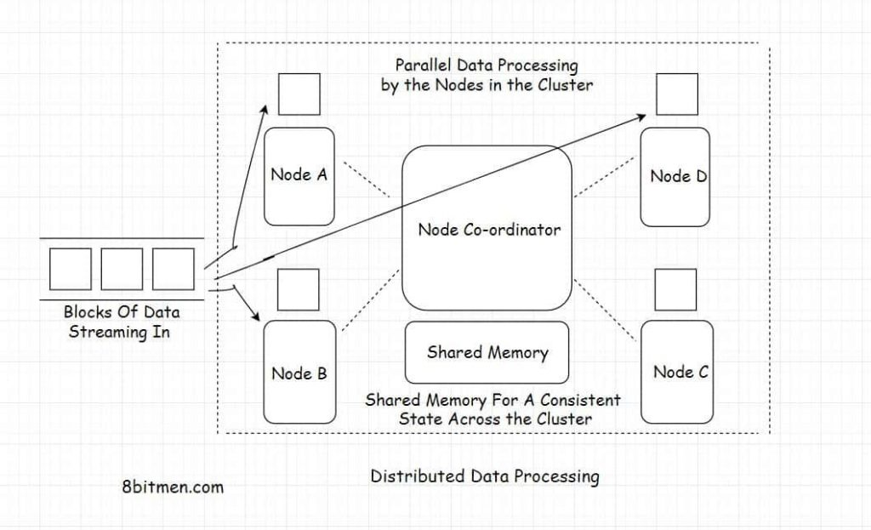
Distributed systems make it possible to store, process, and analyze massive data sets efficiently and reliably - a core requirement in the Big Data era
Data Partitioning: Split large datasets into chunks for parallel processing
Task Distribution: Each node handles a portion of the workload
Data Replication: Copies of data are stored across nodes for fault tolerance
Coordination: A master node or manager assigns and monitors tasks

Slide 10
Same problem but different approaches
Hadoop & Spark: Powerful Engines for Big Data Processing

Slide 11
02
Hadoop
Introduction to Hadoop architecture and HDFS

Slide 12

Hadoop
open source framework that is used to efficiently store and process large datasets ranging in size from gigabytes to petabytes of data. Instead of using one large computer to store and process the data, Hadoop allows clustering multiple computers to analyze massive datasets in parallel more quickly

Slide 13
Main modules
Hadoop Distributed File System (HDFS) – A distributed file system that runs on standard or low-end hardware. HDFS provides better data throughput than traditional file systems, in addition to high fault tolerance and native support of large datasets
Yet Another Resource Negotiator (YARN) – Manages and monitors cluster nodes and resource usage. It schedules jobs and tasks
MapReduce – A framework that helps programs do the parallel computation on data. The map task takes input data and converts it into a dataset that can be computed in key value pairs. The output of the map task is consumed by reduce tasks to aggregate output and provide the desired result
Hadoop Common – Provides common Java libraries that can be used across all modules

Slide 14

Hadoop Distributed File System
A distributed file system designed to store and access very large files (100s of TB or PB) with high throughput on commodity hardware
Files are split into blocks (default 128MB)
Blocks are distributed across DataNodes
Replication factor = 3 (default), for fault tolerance
No two replicas are stored on the same DataNode

Slide 15
Key feature HDFS
Stores data across multiple nodes for horizontal scalability
Distributed & Scalable
Data is replicated (default 3 copies) to prevent loss on node failure
Fault Tolerant
Feature
Optimized for large, sequential data reads with a write-once model
High Throughput Access
Files are split into blocks (e.g., 128MB) reduces seek time and speeds up access
Block-Based Storage

Slide 16
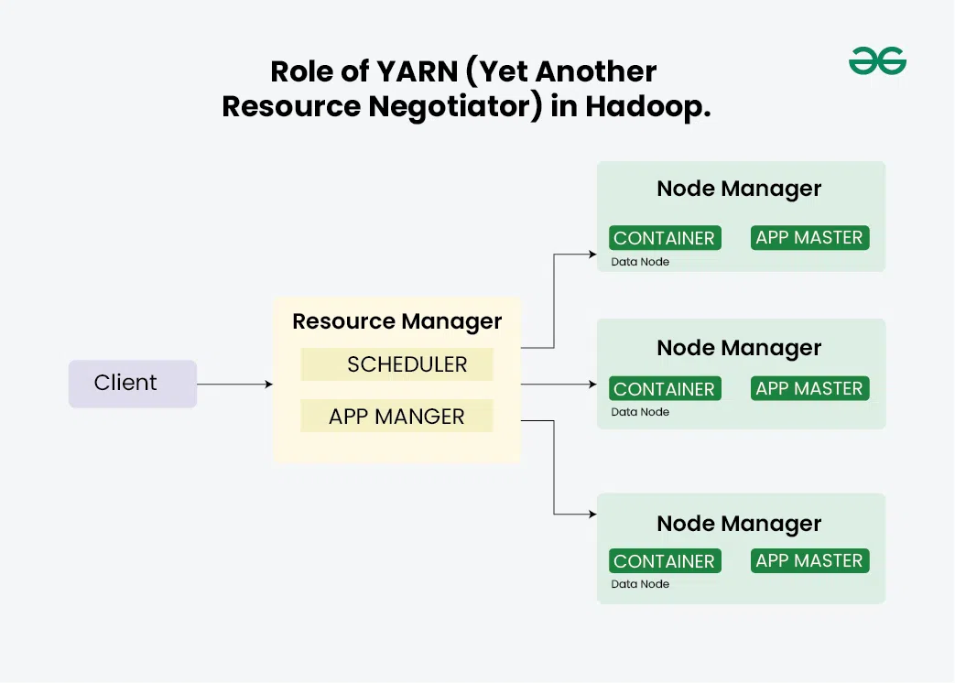
Yet Another Resource Negotiator
Resource management layer of Hadoop. It enables Hadoop to support multiple data processing engines (e.g., MapReduce, Spark, Flink) by decoupling job scheduling and resource management
ResourceManager (RM): Manages global resources and scheduling
NodeManager (NM): Runs on each data node to manage resources and monitor tasks

Slide 17
Key feature YARN
Dynamically allocates CPU, memory, disk across jobs
Resource Management
Supports flexible schedulers (FIFO, Fair, Capacity)
Job Scheduling
Feature
Runs multiple applications on the same cluster efficiently
Scalability & Flexibility
Optimizes cluster utilization and app-level monitoring via AM
Improved Performance

Slide 18
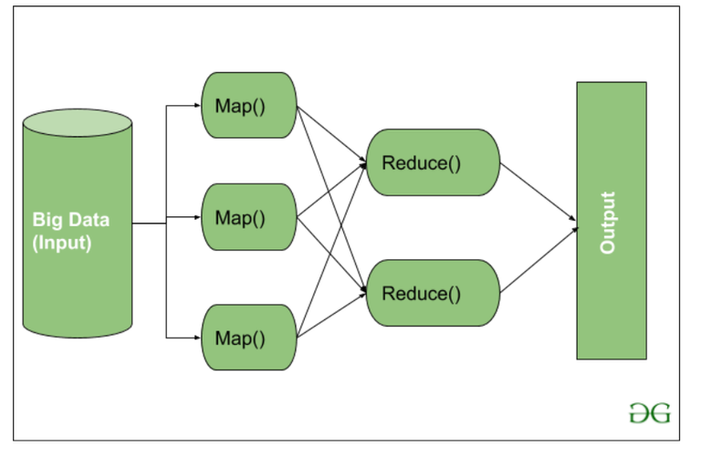
MapReduce - Parallel Data Computation
A programming model for processing large datasets in a distributed manner. Divided into two main phases: Map and Reduce
Map phase: Splits input data and processes it in parallel to generate key-value pairs
Reduce phase: Groups key-value pairs by key and aggregates them to produce final results

Slide 19
Hadoop Common – Core Utilities
Shared Java Libraries and Tools
File I/O, serialization, RPC, security, configuration
Ensures module compatibility and smooth communication between HDFS, MapReduce, YARN

Slide 20
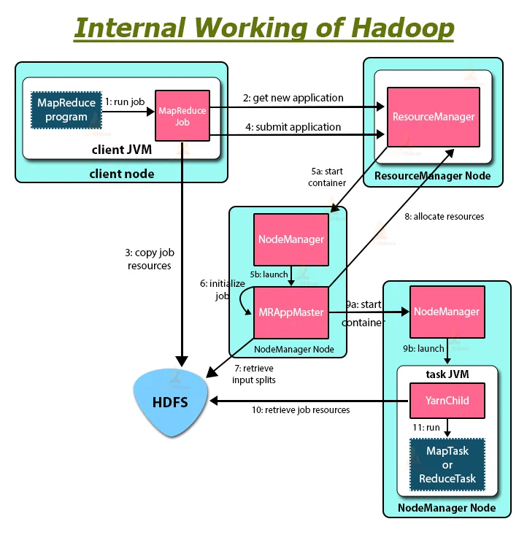
How Does Hadoop Work?
Data is loaded into HDFS, where it's split into blocks and distributed across DataNodes.
MapReduce jobs are submitted to the ResourceManager.
The job is divided into map tasks, each working on a block of data.
Map tasks produce intermediate results, which are shuffled and sorted.
Reduce tasks aggregate results and generate final output.
The results are stored back in HDFS or passed to other applications.

Slide 21
Advantages
Scalability: Easily scale to thousands of machines
Cost-effective: Uses low-cost hardware to process big data
Fault Tolerance: Automatic recovery from node failures
High Availability: Data replication ensures no loss even if nodes fail
Flexibility: Can handle structured, semi-structured and unstructured data
Open-source and Community-driven: Constant updates and wide support

Slide 22
Disadvantages
Not ideal for real-time processing (better suited for batch processing).
Complexity in programming with MapReduce.
High latency for certain types of queries.
Requires skilled professionals to manage and develop.

Slide 23
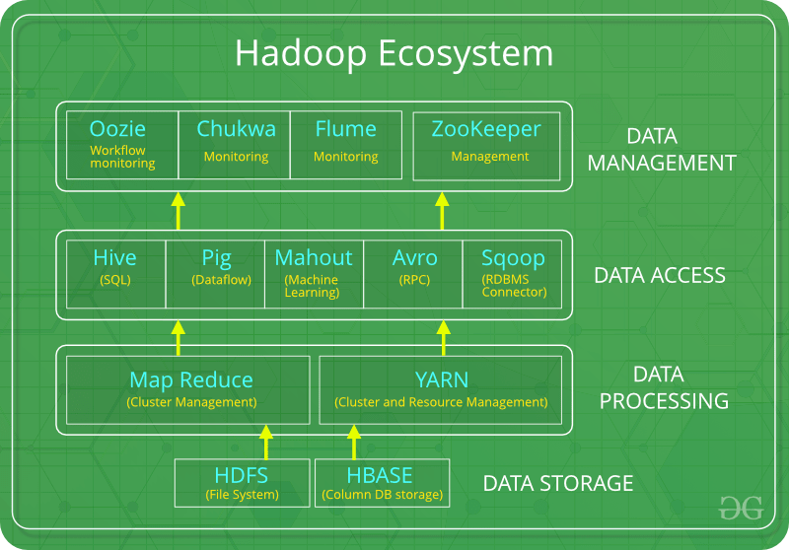
Hadoop Ecosystem
HDFS: Hadoop Distributed File System
YARN: Yet Another Resource Negotiator
MapReduce: Programming based Data Processing
Spark: In-Memory data processing
PIG, HIVE: Query based processing of data services
HBase: NoSQL Database
Mahout, Spark MLLib: Machine Learning algorithm libraries
Solar, Lucene: Searching and Indexing
Zookeeper: Managing cluster
Oozie: Job Scheduling

Slide 24
03
Spark
Key features and advantages of Apache Spark

Slide 25

Apache Spark
An open-source distributed processing system used for large-scale data workloads. It leverages in-memory caching and optimized query execution to enable fast analytical queries on datasets of any size. Apache Spark provides development APIs in Java, Scala, Python, and R, and supports code reuse across various workloads such as batch processing, interactive queries, real-time analytics, machine learning, and graph processing

Slide 26
Main features
Multi-language Support: Provides APIs for Scala, Java, Python, and R, enabling development in multiple languages
High Speed: Up to 100x faster in-memory and 10x faster on disk compared to Hadoop
Platform Flexibility: Runs seamlessly on Hadoop, Kubernetes, Mesos, Standalone, and cloud environments
General-Purpose Engine: Includes libraries for SQL (Spark SQL), machine learning (MLlib), streaming (Spark Streaming), and graph processing (GraphX), allowing them to be combined in one application
Advanced Analytics: Supports not only MapReduce but also real-time data processing, SQL queries, graph algorithms, and machine learning for complex analytics

Slide 27
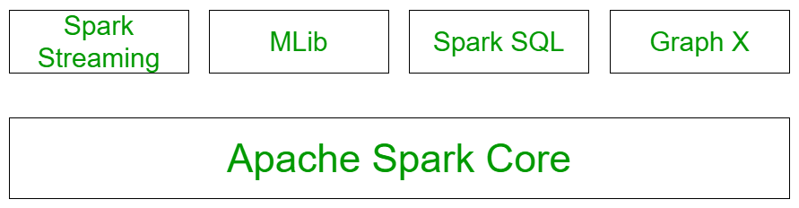
Main components

Slide 28
Spark core
All the functionalities being provided by Apache Spark are built on the highest of the Spark Core. It delivers speed by providing in-memory computation capability. Spark Core is the foundation of parallel and distributed processing of giant dataset. It is the main backbone of the essential I/O functionalities and significant in programming and observing the role of the spark cluster. It holds all the components related to scheduling, distributing and monitoring jobs on a cluster, Task dispatching, Fault recovery
It contains the basic functionality of spark. (Task scheduling, memory management, fault recovery, interacting with storage systems)
Home to API that defines RDDs.

Slide 29
Spark SQL Structured data
The Spark SQL component is built above the spark core and used to provide the structured processing on the data. It provides standard access to a range of data sources. It includes Hive, JSON, and JDBC. It supports querying data either via SQL or via the hive language. This also works to access structured and semi-structured information. It also provides powerful, interactive, analytical application across both streaming and historical data. Spark SQL could be a new module in the spark that integrates the relative process with the spark with programming API
It is a Spark package for working with structured data
It Supports many sources of data including hive tablets, parquet, json
It allows the developers to intermix SQK with programmatic data manipulation supported by RDDs in python, scala and java

Slide 30
Spark Streaming
Spark streaming permits ascendible, high-throughput, fault-tolerant stream process of live knowledge streams. Spark can access data from a source like a flume, TCP socket. It will operate different algorithms in which it receives the data in a file system, database and live dashboard. Spark uses Micro-batching for real-time streaming. Micro-batching is a technique that permits a method or a task to treat a stream as a sequence of little batches of information. Hence spark streaming groups the live data into small batches. It delivers it to the batch system for processing
Enables processing of live streams of data like log files generated by production web services
The API's defined in this module are quite similar to spark core RDD API's

Slide 31
Mllib & GraphX
Mllib Machine Learning
GraphX graph processing
MLlib is Spark’s scalable machine learning library designed to simplify ML implementation. It includes various algorithms such as classification, regression, clustering, and collaborative filtering
GraphX is an API for graph processing and parallel execution. It supports network analytics, clustering, classification, traversal, searching, and pathfinding. It optimizes the representation of vertices and edges, especially for primitive data types. Core operations include subgraphs, vertex joins, message aggregation, and an optimized Pregel API

Slide 32
Main applications
The data generated by systems aren't consistent enough to mix for analysis. To fetch consistent information from systems we will use processes like extract, transform and load and it reduces time and cost since they are very efficiently implemented in spark
It is tough to handle the time generated data like log files. Spark is capable enough to work well with streams of information and reuse operations
As spark is capable of storing information in memory and might run continual queries quickly, it makes it straightforward to figure out the machine learning algorithms that can be used for a particular kind of data

Slide 33
04
PySpark
Overview of PySpark and its role in big data processing

Slide 34
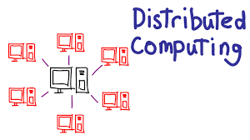
Distributed Computing
A computing model where large computational tasks are divided and executed across multiple machines (nodes) that work in parallel. Think of it as breaking a huge job into smaller parts and assigning each part to a different worker
Speed: Multiple nodes work simultaneously
Scalability: Add more nodes to handle more data
Fault tolerance: If one node fails, others continue

Slide 35
PySpark
Python API for Apache Spark, allowing Python developers to use the full power of Spark’s distributed computing framework with familiar Python syntax. It bridges the gap between Python’s ease of use and Spark’s processing power
Python-Friendly: Build Spark applications using pure Python great for data scientists and engineers
Handles Big Data: Efficiently process huge datasets across multiple machines
Rich Libraries: Includes modules for SQL (pyspark.sql), machine learning (pyspark.ml), and streaming (pyspark.streaming)
DataFrame & SQL API: Work with structured data using powerful, SQL-like operations

Slide 36
PySpark Modules
PySpark is built in a modular way, offering specialized libraries for different data processing tasks
Modules | Description
pyspark.sql | Work with structured data using DataFrames and SQL queries
pyspark.ml | Build machine learning pipelines (classification, regression, clustering, etc)
pyspark.streaming | Process real-time data streams (e.g., Twitter feed, logs)
pyspark.graphx | Handle graph computations and social network analysis (Scala/Java primarily)

Slide 37
High-level overview PySpark work
When run a PySpark application, it follows a structured workflow to process large datasets efficiently across a distributed cluster
Driver Program: Your Python script that initiates and controls the Spark job
SparkContext: Connects the driver to the Spark cluster and manages job configuration
RDDs/DataFrames: Data structures that are distributed and processed in parallel
Cluster Manager: Schedules and allocates resources to worker nodes (e.g., YARN, Mesos, Kubernetes)
Executor Nodes: Run the actual tasks in parallel and return results to the driver

Slide 38
Options for handling big data efficiently
Advantage | PySpark | Pandas | Splash | Apache Flink
Suitable for big data | Yes | No | No | Yes
Expand | Yes | No | Yes | Yes
Complexity | High | Low | Low | High
Character | Big Data Processing | Small Data Processing | Flexible Use Cases | Stream Data Processing
Ease of use | Medium | High | High | Medium
Resource Requirements | High | Low | Low | High

Slide 39
05
Commands
Commonly used PySpark functions with examples

Slide 40
Common PySpark Functions
Create and Display DataFrame:
spark.createDataFrame(data, schema)
df.show()
Select and Filter Data:
df.select("column")
df.filter(df["column"] > 100)
df.where(df["column"] == "value")
Add or Modify Column:
df.withColumn("new_col", df["old_col"] * 2)

Slide 41
Common PySpark Functions
Group and Aggregate Data:
df.groupBy("column").count()
df.groupBy("column").agg({"value": "avg"})
Sort Data:
df.orderBy("column")
df.orderBy(df["column"].desc())

Slide 42
Common PySpark Functions
Handle Missing Values:
df.na.fill(0)
df.na.drop()
df.na.replace("old", "new")
Join DataFrames:
df1.join(df2, df1.id == df2.id, "inner")
Drop Column:
df.drop("column")

Slide 43
Resources
Icons
Apache Hadoop
Introduction to Hadoop - GeeksforGeeks
Hadoop là gì? – Giải thích về Apache Hadoop – AWS
Spark
Apache Spark™ - Unified Engine for large-scale data analytics
Spark là gì? – Giới thiệu về Apache Spark và Phân tích – AWS
PySpark
https://www.geeksforgeeks.org/data-science/introduction-pyspark-distributed-computing-apache-spark/
PySpark Overview — PySpark 4.0.0 documentation

Slide 44
Thanks!

